Slide 1

Part III Category learning with a pLoT
Fausto Carcassi

Slide 2
Summary so far
pLoT as a picture of cognition
Some formal tools:
Formal grammars
Probabilistic PCFG
Compositional interpretation
(Approximate) Bayesian inference
Part I | Introduction: On the very idea of an LoT
Part II | Technical background
Part III | Bayesian program induction (LOTlib3)
Part IV | Case studies
Part V | Summary & Future prospects

Slide 3
Plan for session
We’ll consider some examples
Combine the technical tools
Build up to a pLoT category learning simulation
Part I | Introduction: On the very idea of an LoT
Part II | Technical background
Part III | Bayesian program induction (LOTlib3)
Part IV | Case studies
Part V | Summary & Future prospects

Slide 4
Example 1: Binary strings

Slide 6
Example 2: The visual domain

Slide 7
Shape grammar
What could we mean by shape grammar?
What would you include in a shape grammar?

Slide 8
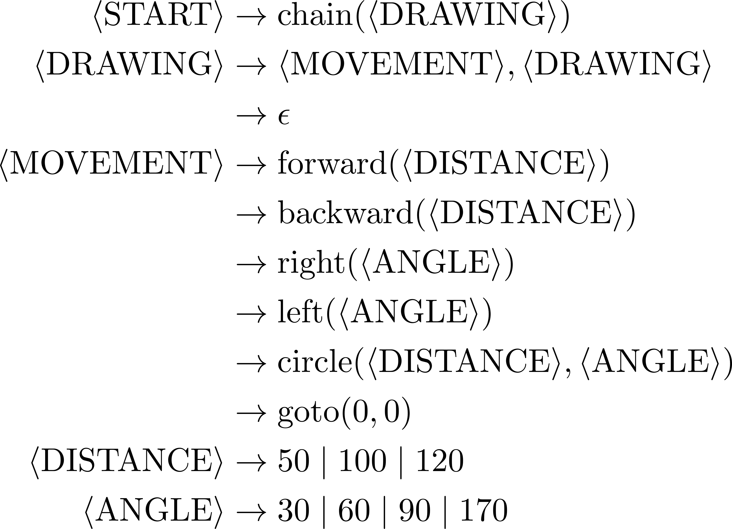
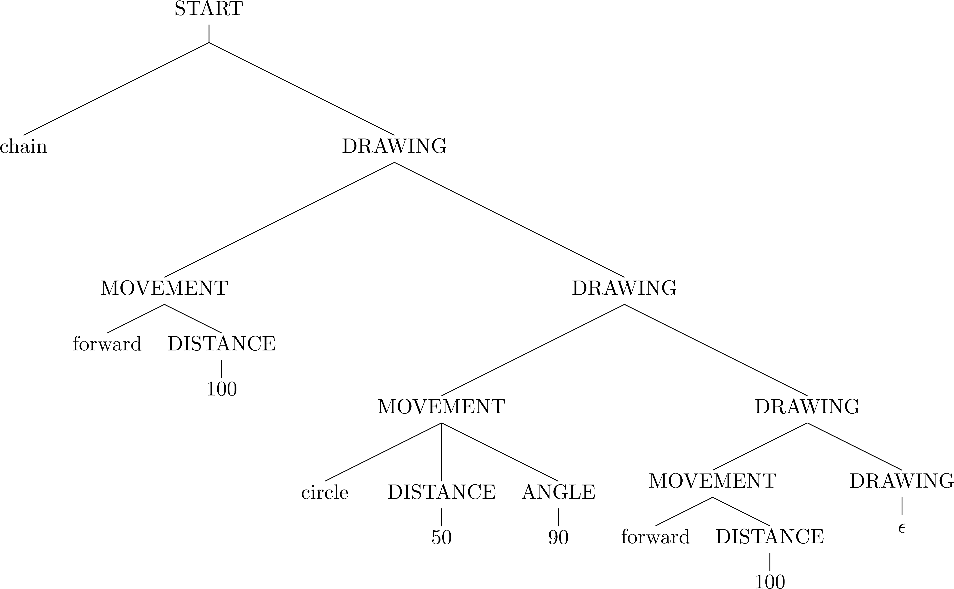
Shape grammar

Slide 9
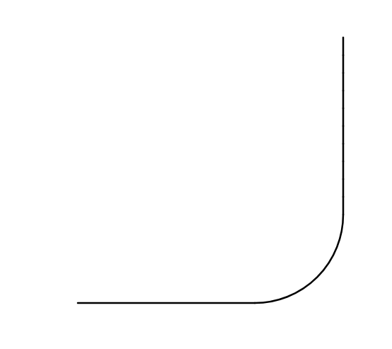
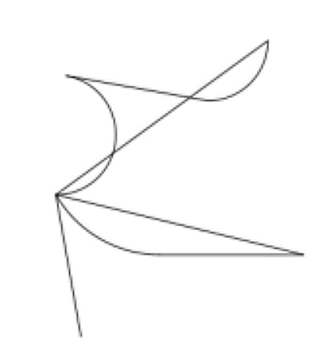
Shape semantics

Slide 10
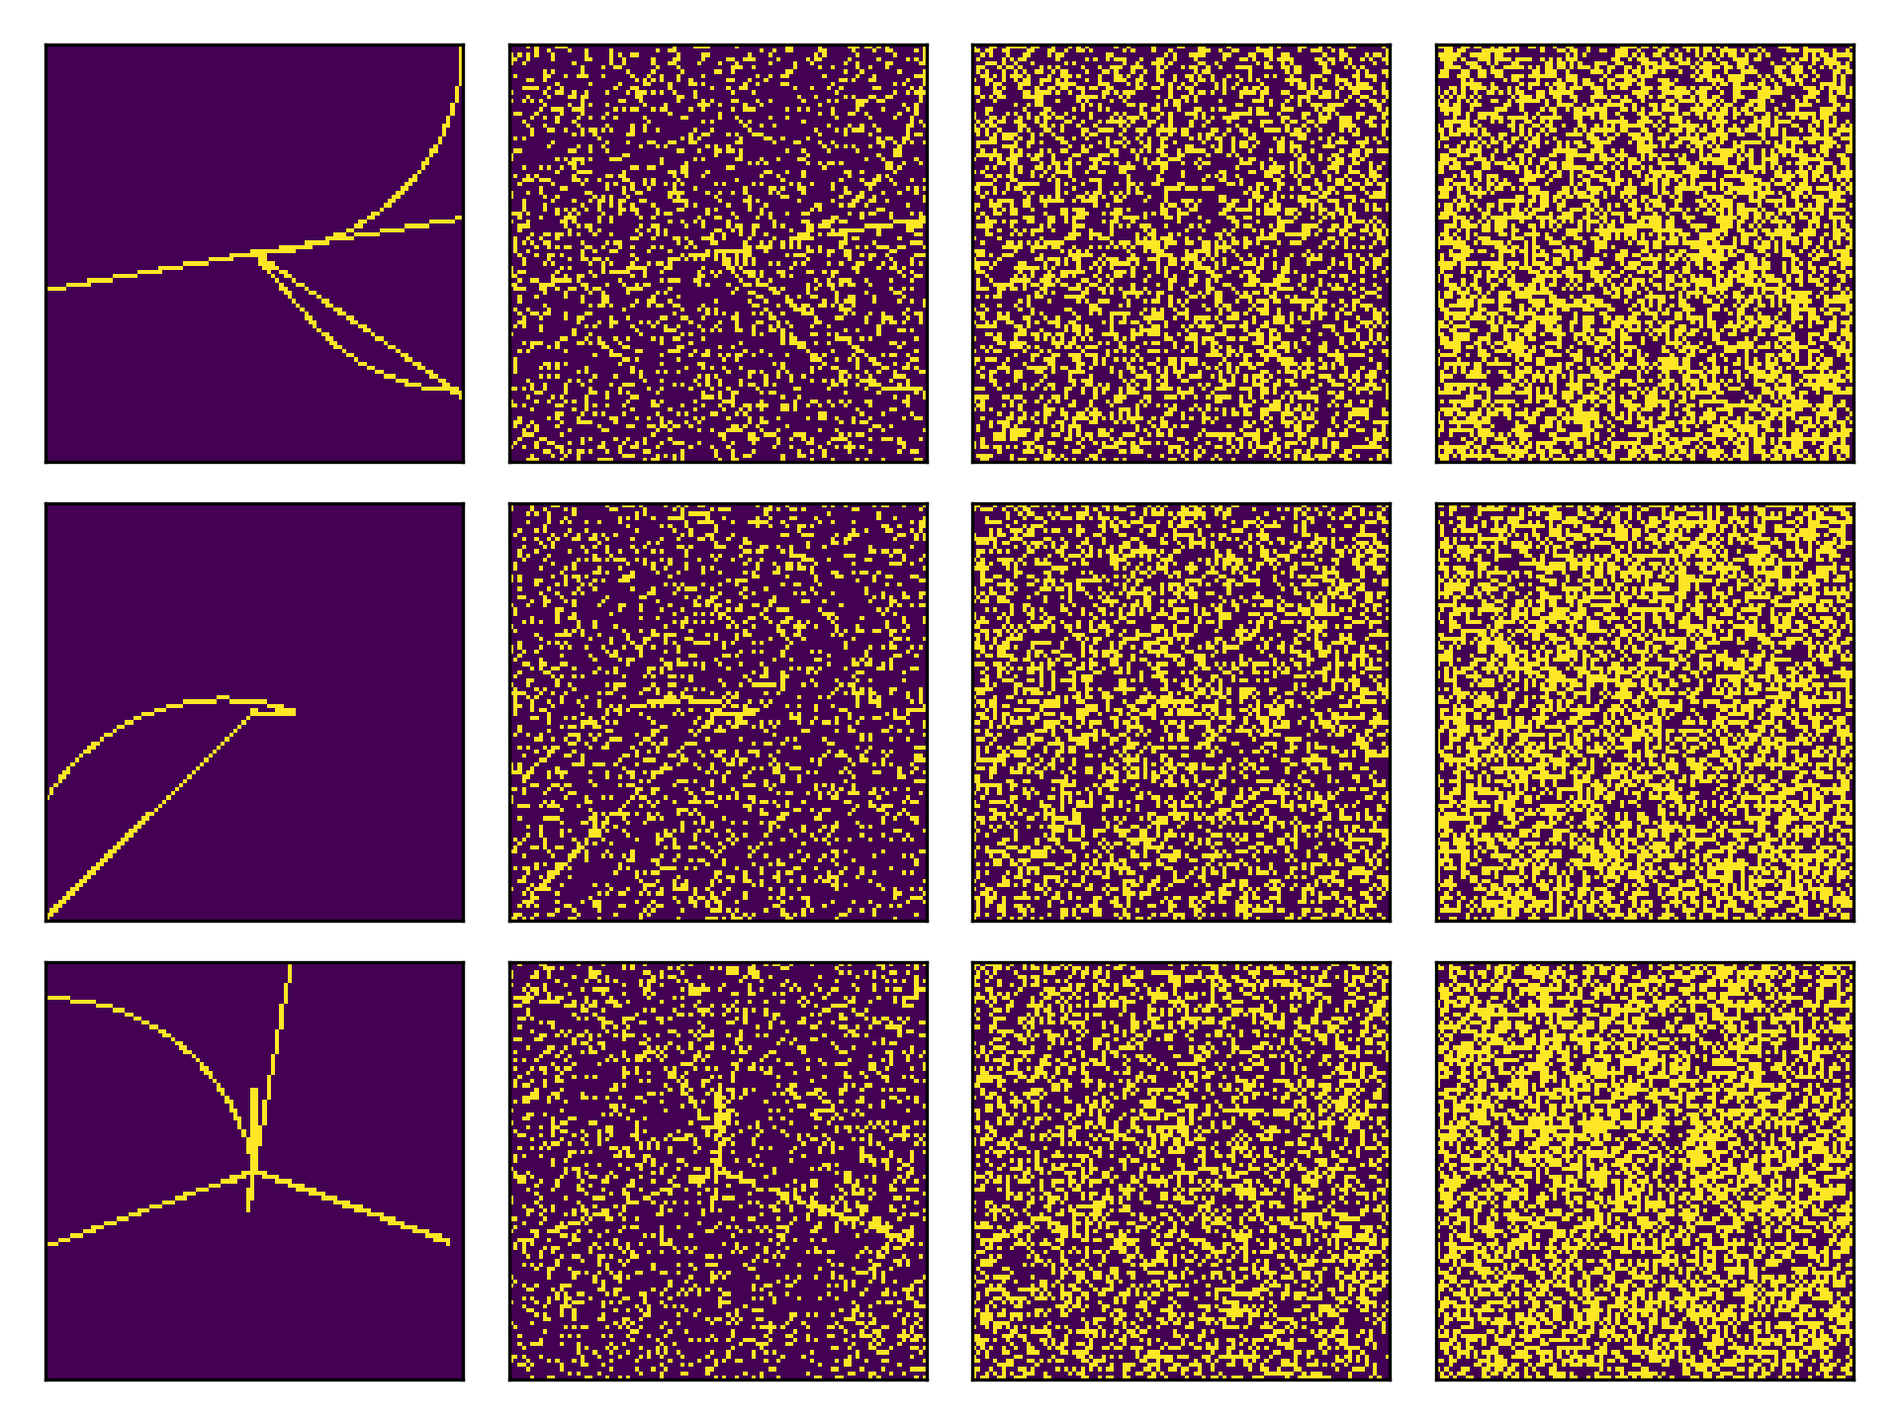
Shape observations

Slide 11
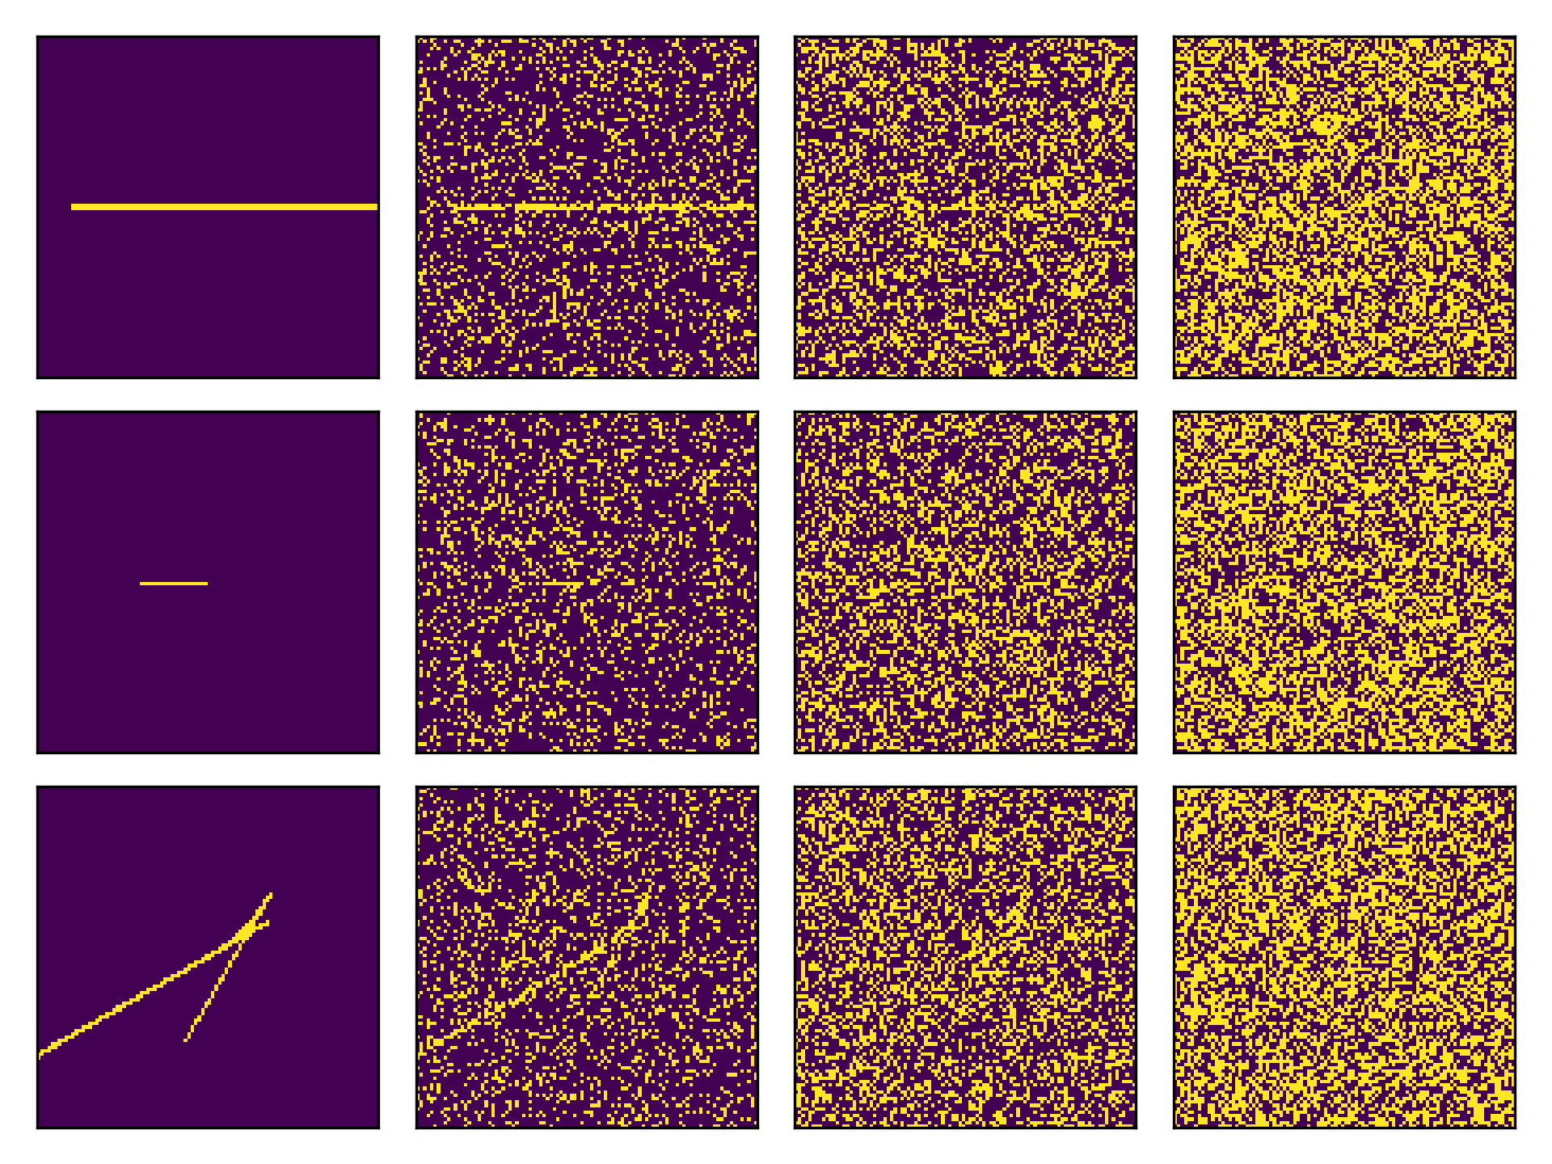


Priors and likelihoods
Observations
Noise level 1
Noise level 2
Noise level 3

Slide 12
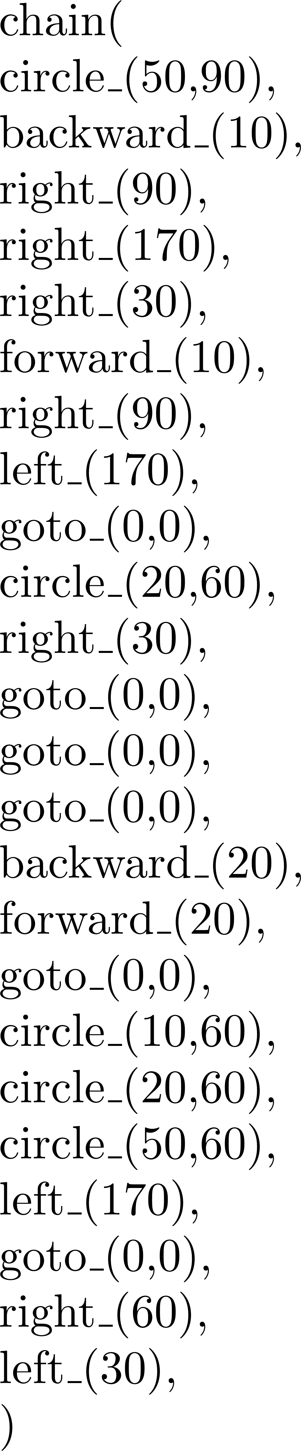
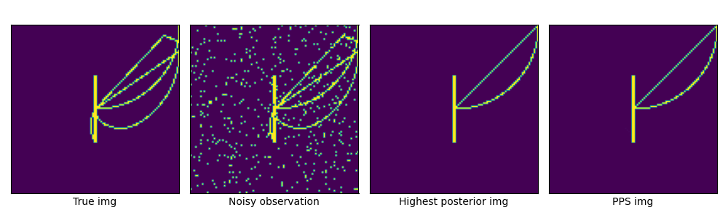
Bayesian inference in the shape grammar
True shape
Noisy observation
Higher posterior shape
Posterior mean

Slide 13
LoT learning models: the big picture
Interpreted PCFG
Defines hypotheses H
Defines a prior over H
Observations O
Generated by true H
Likelihood P(O | H)
Bayesian inference algorithm
Approximate!
Shapes grammar
Each H is a sentence…
…which encodes a shape
Image (with noise)
Multiple H produce same shape!
Likelihood P(image| shape)
MCMC w/ e.g., LOTlib3
Gives us samples from posterior!

Slide 14
Example 3: The auditory domain

Slide 15
Sound grammar
What could we mean by sound grammar?
What would you include in a sound grammar?

Slide 16
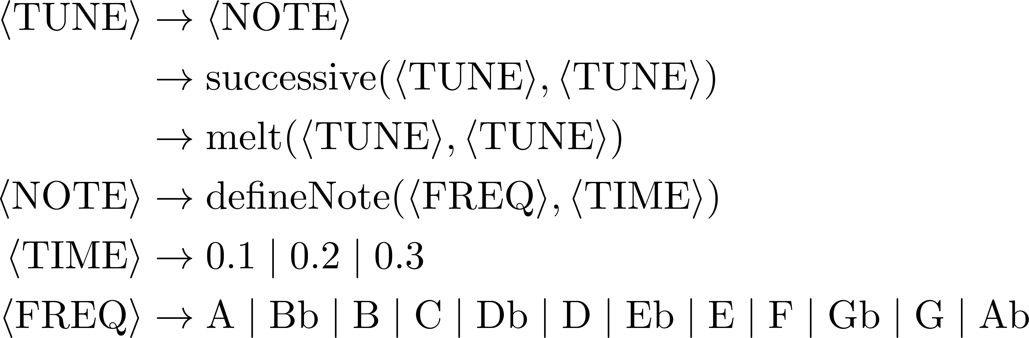
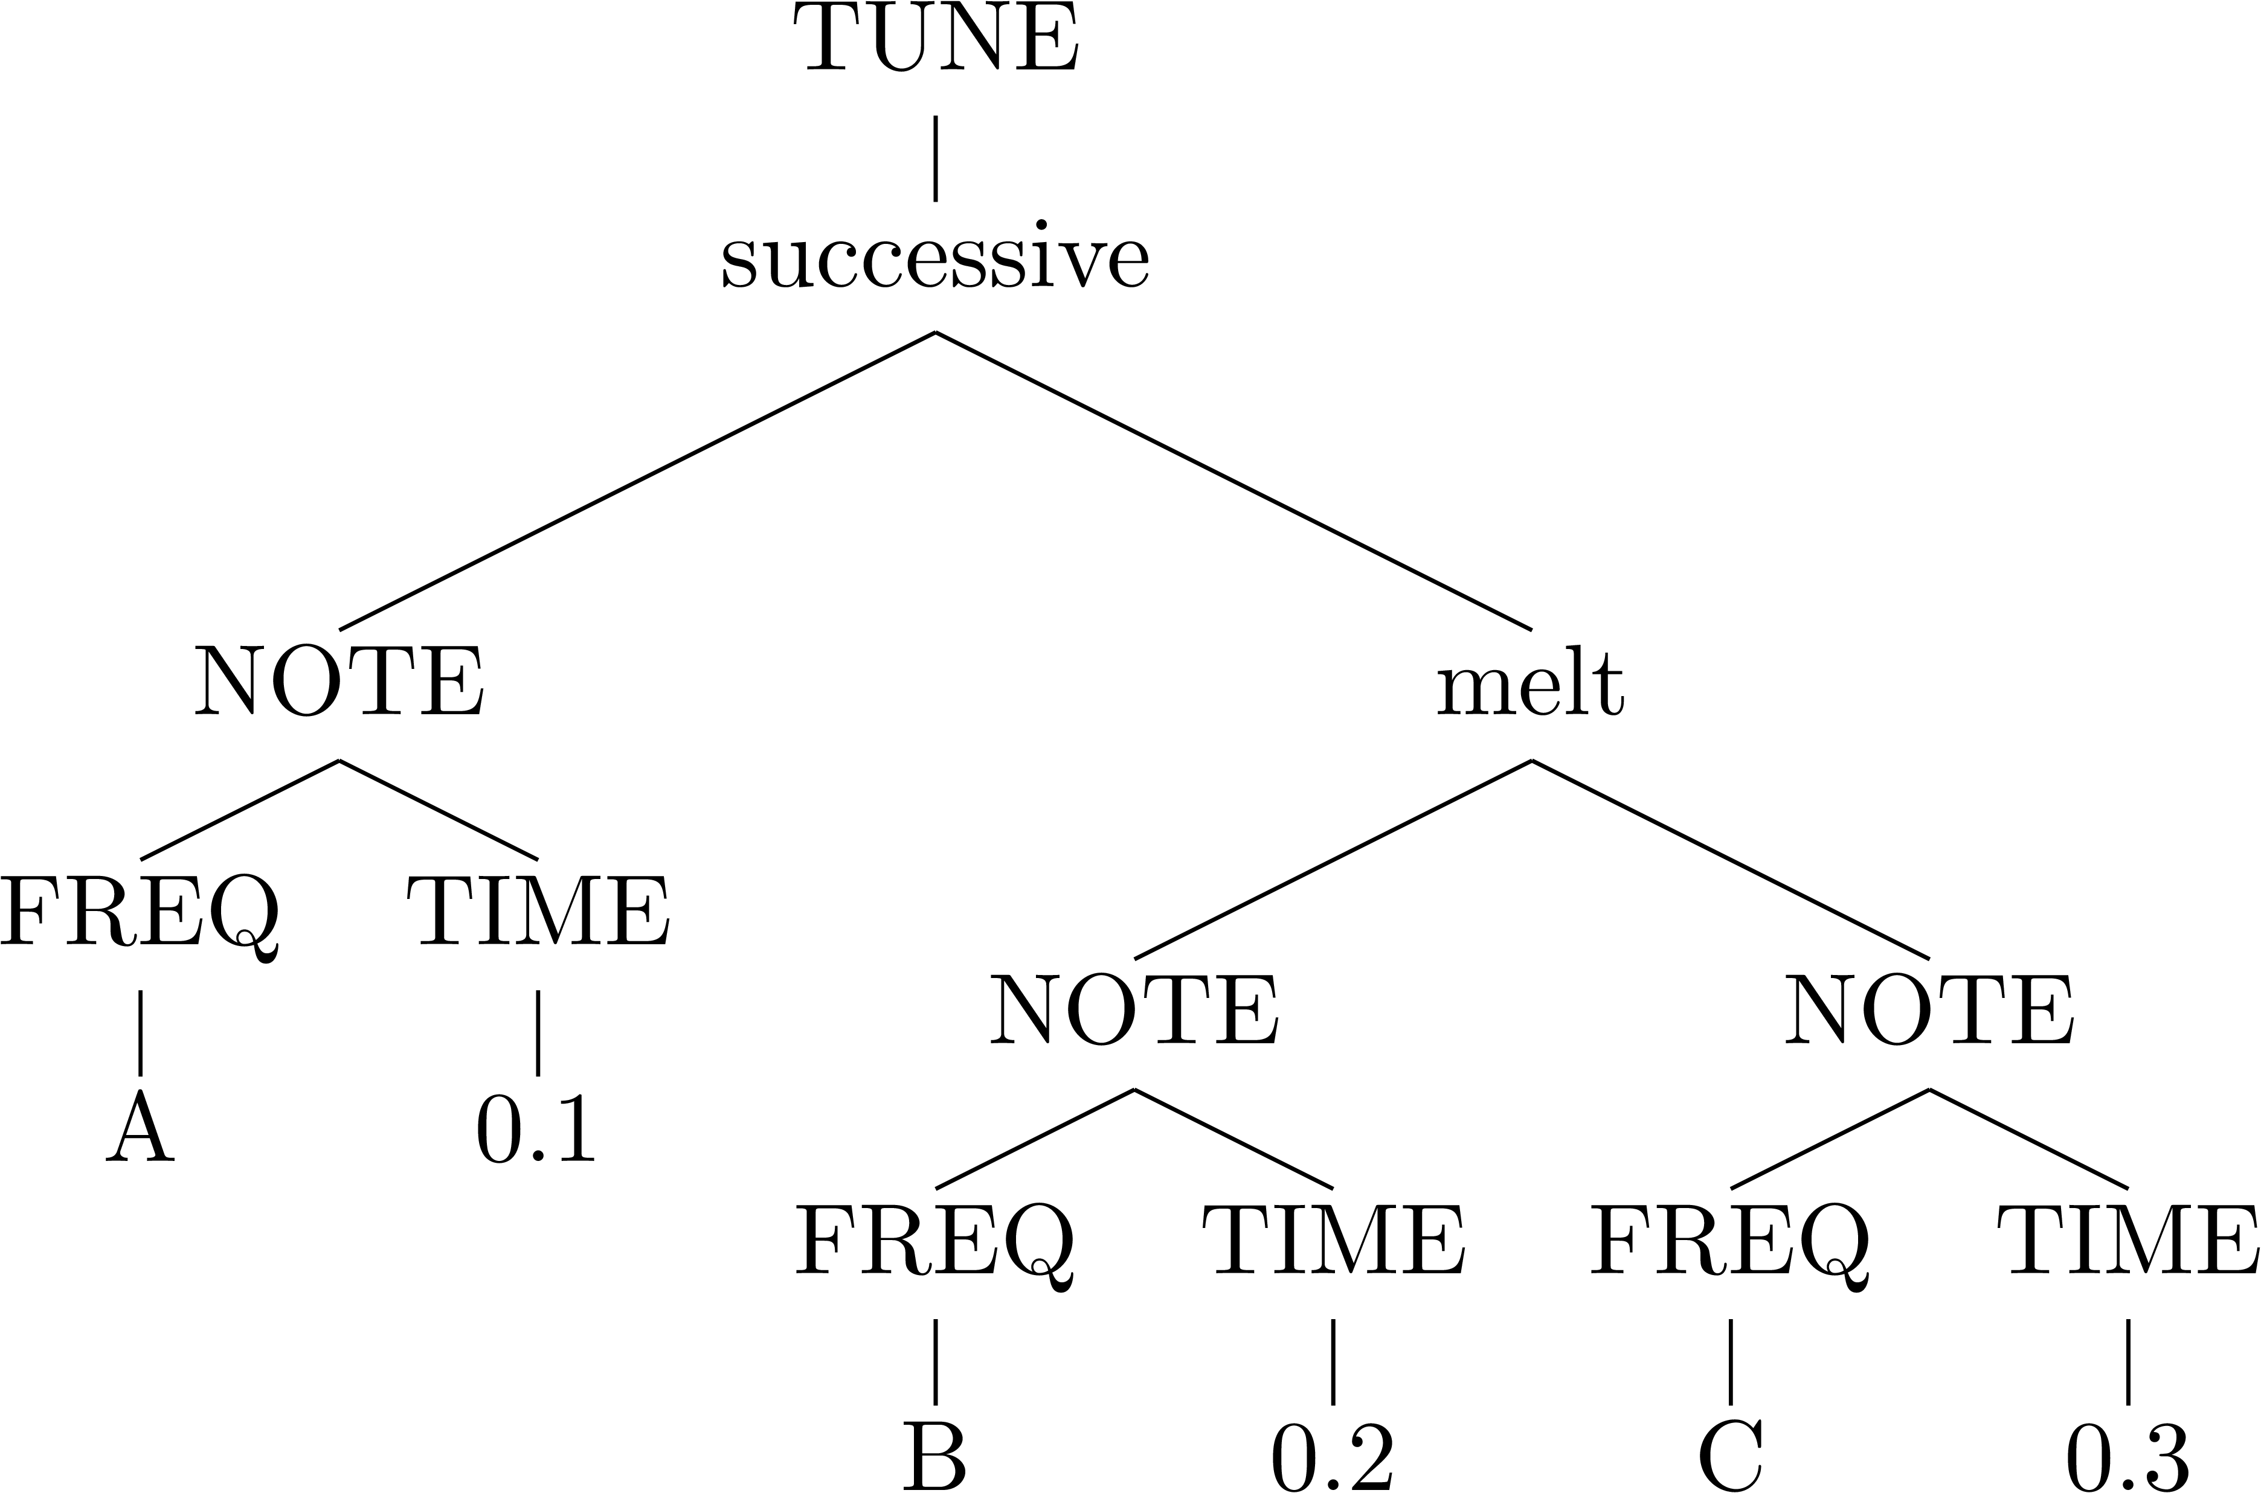
Sound grammar
(For the sake of our ears, let’s only keep A, C, D, E, G)

Slide 17
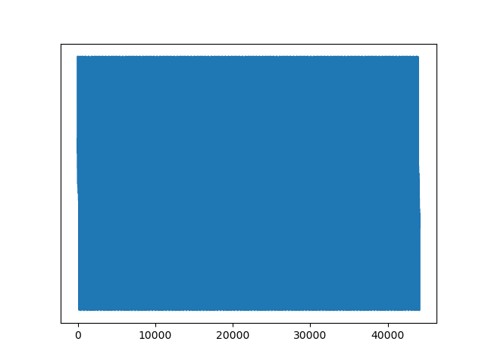
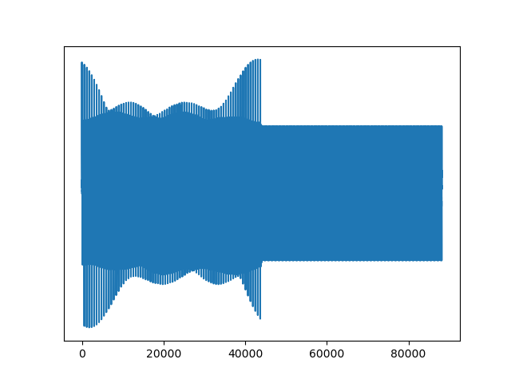


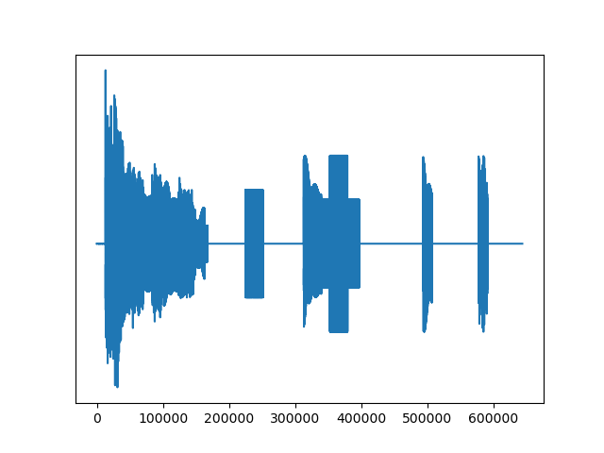
Sound semantics

Slide 18
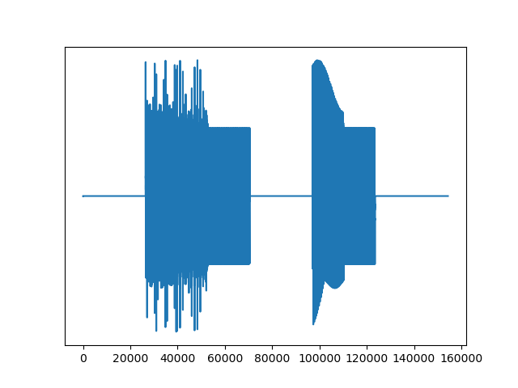
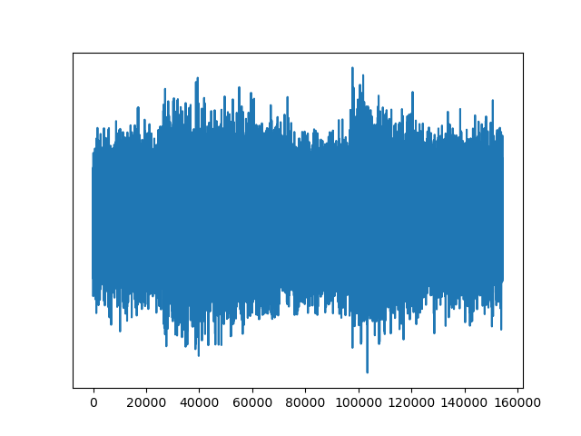
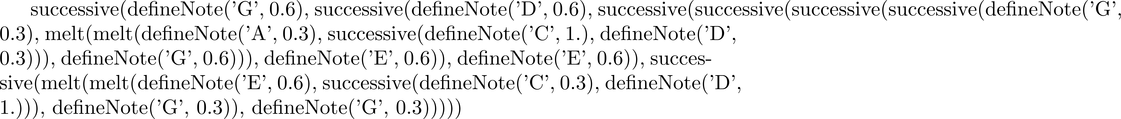
Audio observations

Slide 19
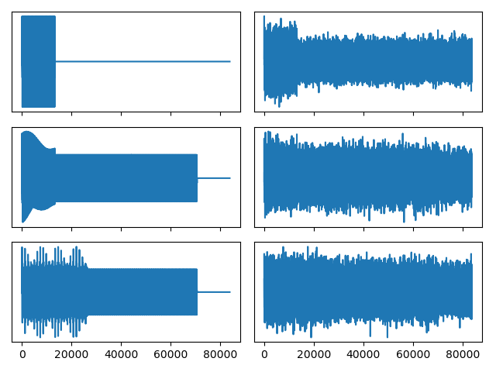


Priors and likelihoods

Slide 20
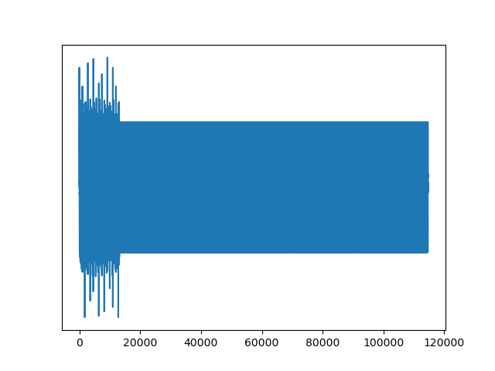
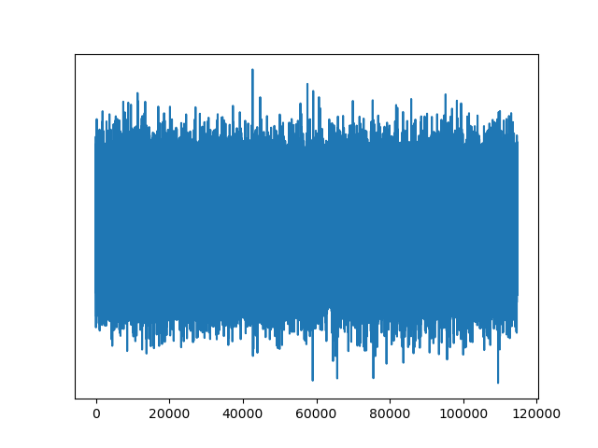
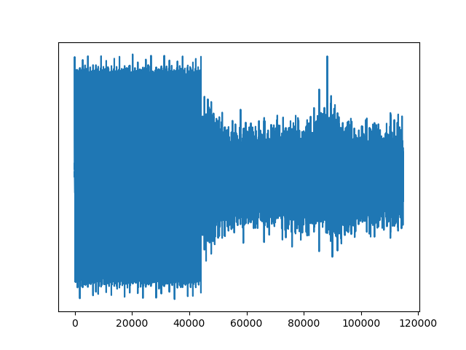
Learning: Bayesian inference in a PCFG
MAP
Posterior mean

Slide 21
LoT learning models: the big picture
Interpreted PCFG
Defines hypotheses H
Defines a prior over H
Observations O
Generated by true H
Likelihood P(O | H)
Bayesian inference
Approximate!
Sound grammar
Each H is a sentence…
…which encodes a sound
Sound (with noise)
Multiple H produce same sound!
Likelihood P(audio | sound)
MCMC w/ e.g., LOTlib3
Gives us samples from posterior!

Slide 22
Summary: Building a pLoT model
Pick a domain, e.g., music, geometry, logical concepts
Write a (plausible) list of primitive concepts
Write a PCFG
Define a likelihood function
Produce an observation
Sample from the PCFG
Hand-design
Use naturally occurring
Run inference algorithm

Slide 23
Important features
Simpler representations have a higher prior
Simpler <--> More probable in the pLoT (PCFG)
In domains above, pLoT sentences denoted single objects
…but each sentence in the pLoT can denote a function
Observations are (inputs, output) tuples
Categories (sets) are a special case with Boolean output
Observations are e.g., samples from the category
Size effect!

Slide 24

Some hypotheses types
Input | Output | Stochastic | Meaning | Example
 | Domain object | No | Single domain object | Shape
 |  | Yes | Graded category | Cup
Domain object | Boolean | No | Category | Primes
 |  | Yes | Graded category
Domain object | Domain object | No | Transformation | Adding 3
 |  | Yes | Stochastic transf | Jumping
… | … | … | …

Slide 25
Conclusions
We saw how to construct a model of category learning w/ a pLoT
Two example domains:
Shapes
Sounds
Many more to be explored!
Next step: Literature using this kind of model.
Part I | Introduction: On the very idea of an LoT
Part II | Technical background
Part III | Bayesian program induction (LOTlib3)
Part IV | Case studies
Part V | Summary & Future prospects

Slide 26
If there’s time left…
Construct a grammar
Grammar for categorization based on binary features
Grammar for encoding binary strings
Improve the two discussed grammars
Modify the shape and sound grammars to be more cognitively plausible.

